Slide 1

Dementia 42%
Pain 57%
Delirium 66%
Psychological symptoms 70%

Slide 2

Agitation
Morbidity
Length of stay
Social care

Slide 3
D
I
S
T
R
E
S
S
E
D
Dementia
Inpatient
Study on
The
Recognition and
Evaluation of
Signs
Signaling
Emotional
Distress

Slide 4
Healthcare professionals are under recognising or under reporting symptoms.
Existing systems to treat symptoms in dementia are rarely used.

Slide 5


Slide 6
Universally recognsied
Familiarity
Staff experience
Innate
Ask family
Ask
Observe

Slide 7

Clear reporting systems
Risk
Chronicity

Slide 8
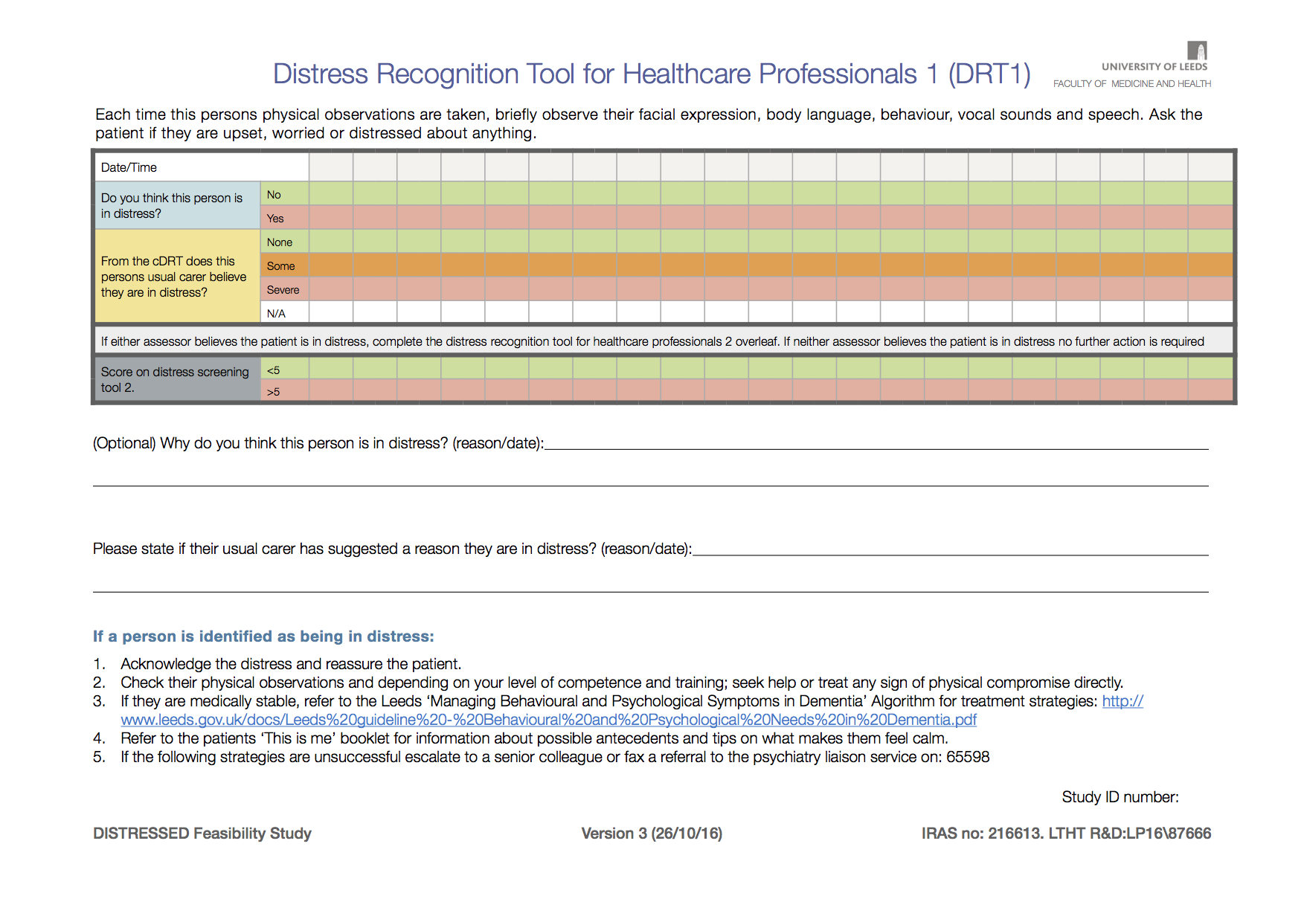
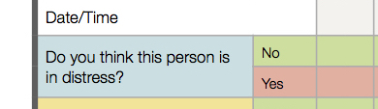

Slide 9
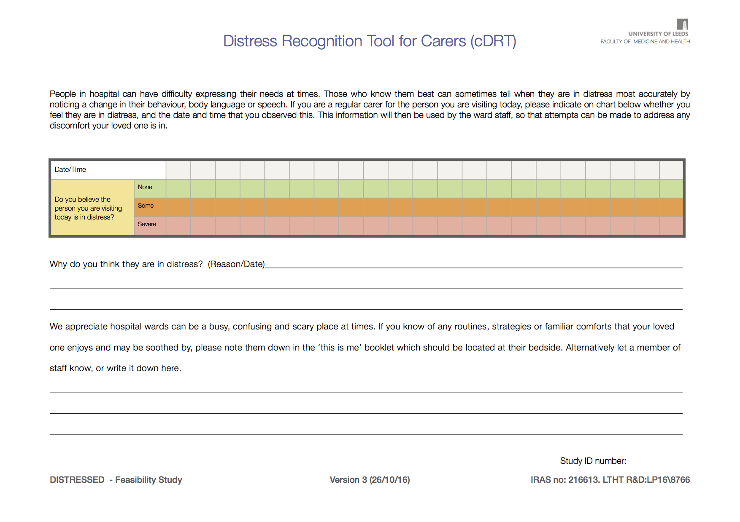
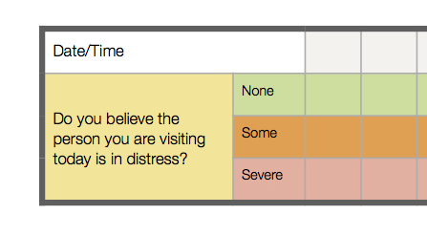

Slide 10
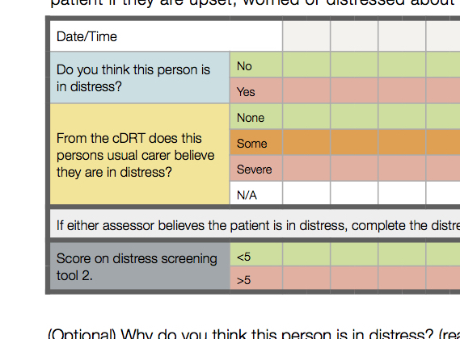

Slide 11
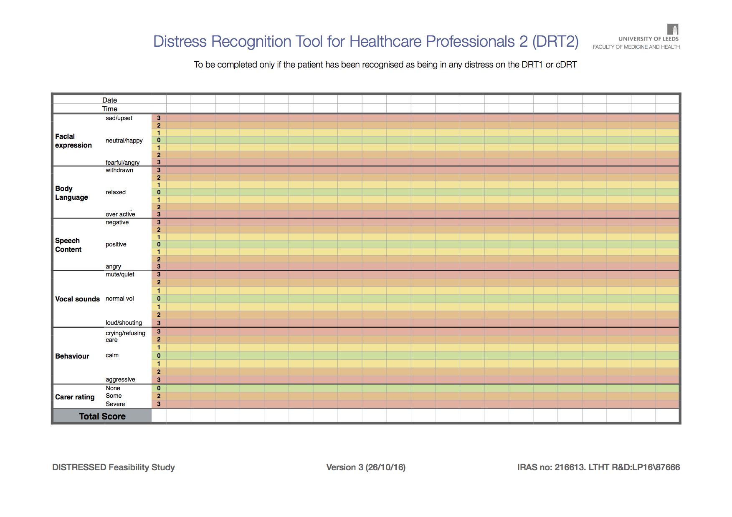

Slide 12
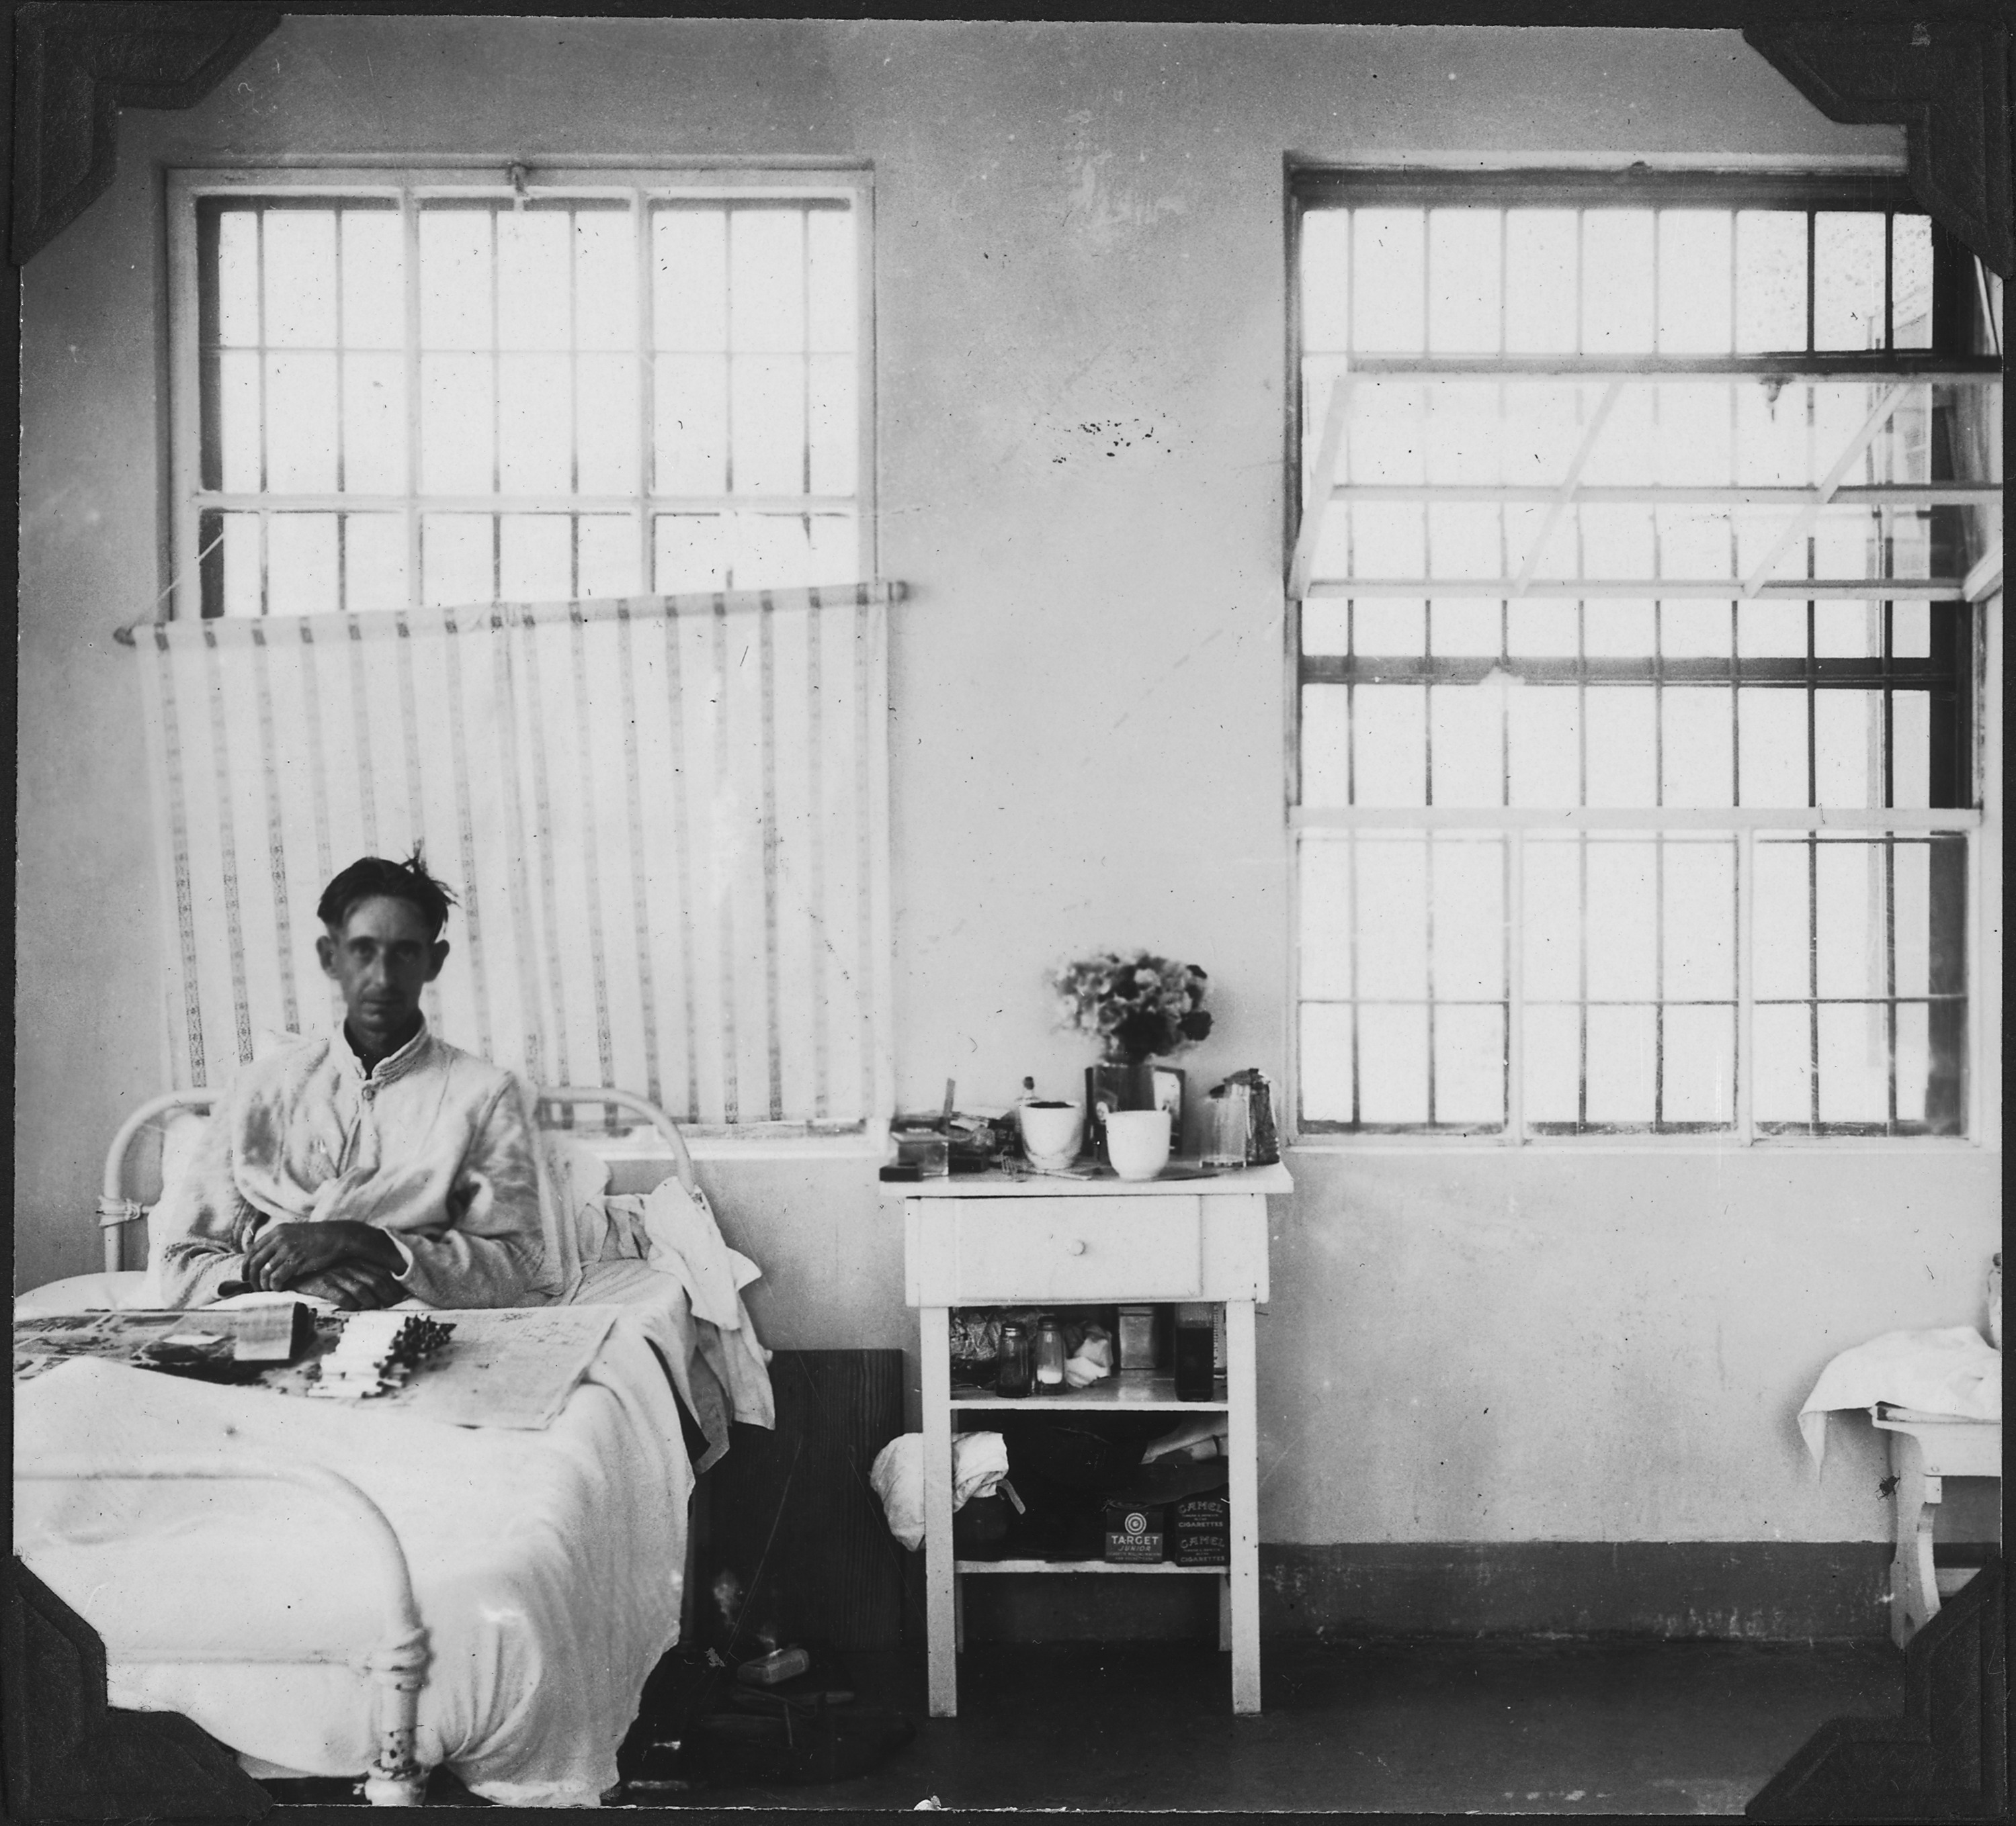
32 patients, 1 had capacity.
346 bed days.
68 Safety huddles.
32 MDTs.
10 stakeholder interviews.

Slide 13
Used 0.9 times per patient per day.
Completed 44% of times observations were taken.
“Quick and easy to use”.
Bank staff less likely to complete.

Slide 14
27 Participants had carers.
cDRT completed 150 times, 0.41 times per patient per day.
Carers and staff valued the input.
Transposition rates of cDRT: 24%.

Slide 15
Distress recorded 52 times.
DRT2 completed 67 times.
DRT2 completed when indicated 18 times.
No associations between distress and MEWS (p=0.36).

Slide 16
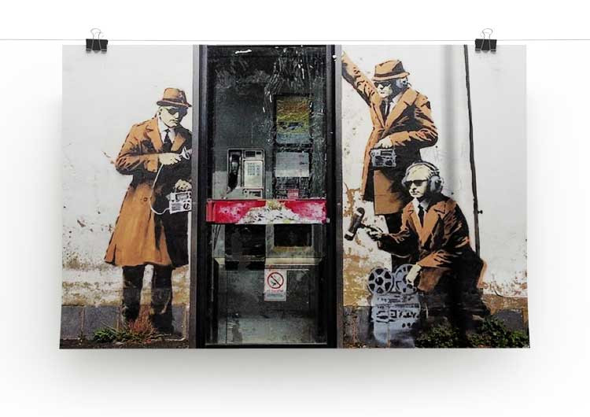
“There was more discussion round distress and the behavioural and psychological symptoms of dementia, it was like that was on everybody's radar.”
Never specifically noted at MDT.
Became an agenda item at huddle.

Slide 17
What are the key process and outcome measures as indicators of the DRT’s impact on patient care?

Slide 18


Slide 19


Dr G Crowther
Dr Cathy Brennan
Prof Mike Bennett
Dr Kath Hall
Dr Abbie Flinders
Prof Allan House
LYPFT R&D Department
LTHT R&D Department

