Slide 1

Improving Health Equity
Patient Carer Race Equality Framework
(PCREF)
Joanna Forster-Adams – Chief Operating Officer
Sophie Valinakis – Head of Health Equity
(14.04.25)

Slide 2

Which one best represents how you feel today?
Question 1

Slide 3




Introducing presenters today
Dr. Jacqui Dyer
(Mental Health Equalities advisor for NHS England)
Hannah Corlett
(Communications Officer)
Dr. Christina Hosker
(Medical Director)
Sophie Valinakis
(Head of Health Equity)

Slide 4
Agenda
Improving Health Equity update
Launching PCREF - Making anti-racism work for all Mental Health providers
Share our local PCREF action plan
Share some local intelligence on racial equity and mental health
Open panel discussion
Share practical steps to being anti-racist & how to get involved
Next steps & close

Slide 5

Improving Health Equity update

Slide 6
Improving Health Equity update
Our mission is to enable equity at the heart of everything we do
We are working to maximise the Trust’s contribution to improving health equity in the populations we serve
Huge thank you for helping us!
In January (2025) the Trust Board approved our Improving Health Equity Strategic Plan 2025 – 2029
Contact lmh-tr.healthequity@nhs.net to receive a copy.

Slide 7

Our Strategic Plan areas of focus
The systematic, unfair and avoidable differences in health
between those with learning disability, neurodiversity, severe and
enduring mental illness, and those without.
2. Tackling racial health inequity within mental health services which have been evidenced to be extensive and persistent.
3. Intersectionality: People at exceptionally high risk of poor health outcomes because they are a member of multiple groups and experience compounding disadvantage e.g. those with a severe mental illness, and from a racialised community, and who also live in an underprivileged community.
4. Our service users who experience deprivation living in the 10% most deprived communities nationally.

Slide 8

Introducing Dr. Jacqui Dyer MBE
Honorary Fellow at King's College London
Independent Health and Social Care Consultant with lived experience,
Mental Health Equalities Advisor for NHSE, and Health Education England (HEE), leading on the Advancing Mental Health Equalities Strategy and the development of the Patient & Carer Race Equality Framework as recommended in the MHARAC and subsequently agreed by the government.
Jacqui was the vice chair of England's Mental Health Taskforce, developing the 5 Year Forward View for Mental Health (NHSE).
Jacqui is an elected Councillor and cabinet member for inclusive economy and equalities having previously jointly held the health and adult social care cabinet portfolio.
co-founder and chair of Lambeth’s Black Thrive Partnership
involved in a range of international networks to elevate the voices of lived experience, community participation and leadership

Slide 9
Making anti-racism work for all
Mental Health providers
Patient and Carer Race Equality Framework
Dr Jacqui Dyer, MBE

Slide 10
Patient and Carer Race Equality Framework
Making anti-racism work for all
Mental Health providers
Dr Jacqui Dyer, MBE
NHS England, National Mental Health Equalities Adviser
Advancing Mental Health Equalities
April 2025
Notes:
Standard title slide

Slide 11

Background/history
NHS England (NHSE) published its first Advancing Mental Health Equalities Strategy in October 2020, laying out plans for addressing inequalities in access, experience and outcomes in mental health care.
The strategy summarises the core actions that are needed to address inequalities and improve care for communities faring worse than others in mental health services. It sets out three avenues to achieve this:
  Supporting local health systems to advance equalities
  Improving the quality and use of data to inform decision making, and
  Creating a diverse and representative workforce which is equipped with the capabilities to achieve change
The Patient and Carer Race Equality Framework (PCREF) is a core part of the Advancing Mental Health Strategy and a key recommendation of the Independent Review of the Mental Health Act 2018, supported by the set up of the MHA African and Caribbean group to support with the aims of the independent review, focusing on the inequalities faced by racialised and culturally and ethnically diverse communities. NHSE agreed to take forward the PCREF soon after the review was published.
The delivery of the Strategy and the development of the PCREF is being overseen by the Advancing Mental Health Equalities Taskforce, and the PCREF Steering Group, established in February 2020, and chaired by Dr Jacqui Dyer, NHSE’s national Mental health Equalities Advisor.

Slide 12

Reclaiming the narrative
The fight against racial inequality and inequity in mental health services is a very personal journey for me.
As a mental health service user and carer for the past few decades my experiential knowledge of mental health services is extensive and my commitment to this agenda is personal, political and professional.
I have been working with vulnerable and racialised groups and communities for many years and have seen the disastrous impact that systemic racism and injustice has had on so many peoples’ lives.
I have lost two brothers who throughout their lives struggled with long term mental health challenges and died at age 53 and 41. In 2022, I also lost my aunt, who died whilst in the care of mental health services.
In early 2019, I was appointed as the Mental Health Equalities Champion for England and am currently the Mental Health Equalities Advisor for NHS England.
To find out more about me and the significant work on advancing mental health equalities please refer to my profile on NHS England
“I am driven by the fight for a fairer system where people from racialised communities no longer have significantly worse experiences”
– Dr Jacqui Dyer, MBE

Slide 13



Historical Context of racism in Mental Health Policies impacting systemic equities in care
Systemic Racism
Funding Disparities and their Impact on care
Barriers to Access
Historical policies have entrenched systemic inequities in mental health care, leading to persistent disparities in access and treatment for racialised communities, necessitating urgent reforms to address these long-standing injustices.
Financial inequities create significant barriers for racialised communities seeking mental health care, including limited availability of culturally competent providers and longer waiting times which results in a significant cost to NHS services. 2025 report by NHS RHO on The Cost of Racism
Insufficient funding for mental health services in racialised communities leads to inadequate treatment options resulting in poorer health outcomes and experiences and increased reliance on crisis interventions

Slide 14



The Consequences of Dehumanisation in Mental Health services
Impact on Patient Trust
Cultural Misunderstandings
Long Term psychological impact
Dehumanisation fosters an environment of mistrust between patients and providers, leading to reluctance in seeking help and sharing critical information about mental health conditions right
Lack of cultural competency among mental health professionals results in misinterpretation of systems and needs, exacerbating the challenges faced by racialized communities in receiving appropriate culturally competent care
The ongoing demonisation of individuals in mental health services contributes to chronic stress and worsen mental health outcomes and experiences, perpetuating cycles of disadvantage and limiting recovery opportunities

Slide 15


Recent Events Highlighting Racial Disparities
Pathways to collective reform
Mental Health Act Bill 2024
Darzi Report 2024
Draft Equality (Race and Disability) Bill 2024
NHSE PCREF 2023
Impact of Societal Unrest
Urgent need for Reform
Societal upheavals, such as race riots have highlighted the mental health implications of discrimination exacerbating existing health disparities among minority communities right and then
The persistent racial disparities in mental health outcomes the critical need for targeted legislative measures to ensure equitable access to mental health care for all

Slide 16
Evolution of the PCREF
18 Pilot Trusts joined to support NHSE
The Crisp commission report and NHSE FYFV MH
NHS England agree to take forward PCREF
CQC and EHRC agreed to work with NHS England
Three sites join
Four Pilot sites join
Six Early Adopter sites join
Official launch of the PCREF
Five more sites join!
2015 – 2016
2018
2019
2020 – 2021
2021 - 2022
2022
2023
2024
2025
Independent review of the MHA – recommended the PCREF, culturally appropriate advocacy, and advance choice documents. The African and Caribbean group (MHARAC) was established to support the aims of the independent review.
NHS England publishes Advancing Mental Health Equalities strategy
Launch of draft PCREF
PCREF included in the NHS Standards Contract
Draft Mental Health Bill
PCREF local engagement via Pilot sites
NHSE Regions set up PCREF Network Groups

Slide 17
What makes the PCREF stand out?
NHS Standards Contract 2024-2025
CQC mental health inspection guidance
Culture of Care Standards
Support from Association of Directors of Adult Social Services in England
NHS England’s Equality Delivery System 2022
EHRC – Public Sector Equality Duty
(Equality Act 2010) UN Committee submission
Bespoke anti-racism training for the workforce
NHS England’s Health Inequalities legal statement 2023
NHS England’s Core 20Plus5
Triangle of Care
Support from other statutory and voluntary and community sectors
NHS England’s Culture of care standards for inpatient services
NHS England's Insightful Provider Board guidance

Slide 18
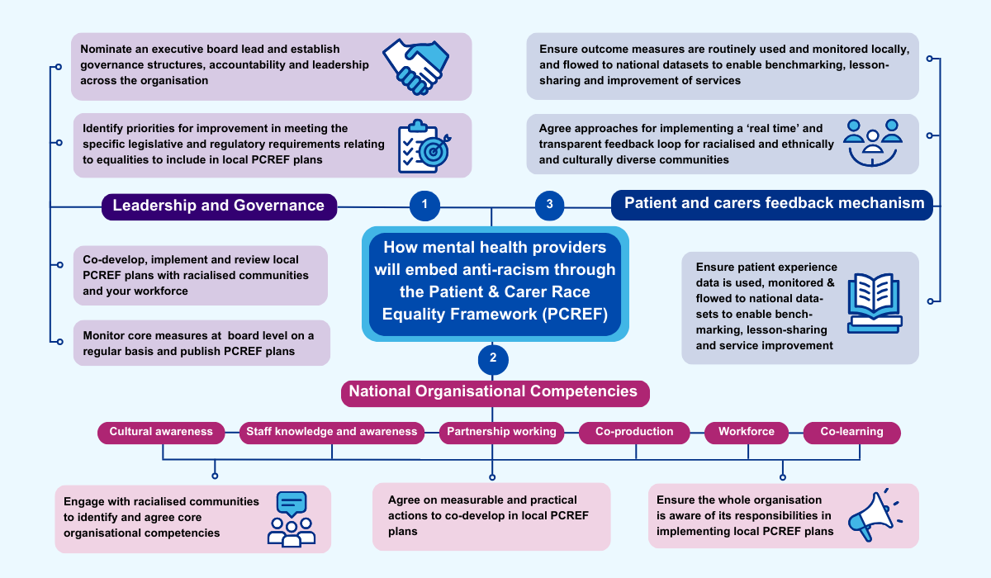

Slide 19
The importance of PCREF influencing the reforms
PCREF aligns closely with the Mental Health Act Reforms and supported by the Darzi Review’s vision for NHS transformation, particularly its Three Big Shifts, which guide the NHS 10-Year Plan:
1. From Quality of Care to Quality of Life
2. From a Healthcare System to a Health and Wellbeing System
3. From Centralised to Localised Care
By embedding PCREF principles in NHS governance, performance metrics, workforce development, and patient feedback mechanisms, we can:
• Address systemic racism in mental health services.
• Improve patient outcomes for racially minoritized groups.
• Drive NHS performance through transparency, accountability, and inclusion.
• Strengthen the role of NHS leadership in reducing racial inequities.

Slide 20

Thank you
Email: england.mentalhealthpmo@nhs.net
Learn more about NHS England recently published Patient and Carer Race Equality Framework: https://www.england.nhs.uk/pcref
And for additional information on the PCREF – including a positive practice guidance, can be found here: NHS Future Collaboration Platform
Learn more about the advancing mental health equalities programme here.

Slide 21
Annex
Resources

Slide 22
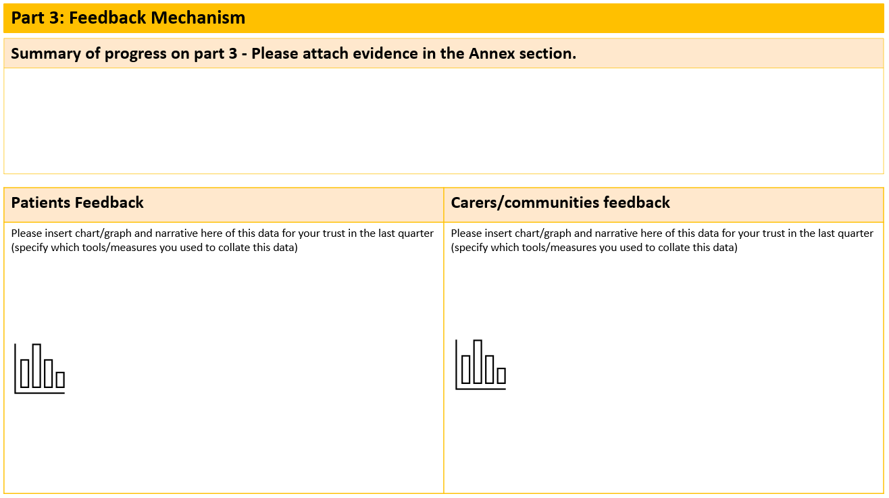
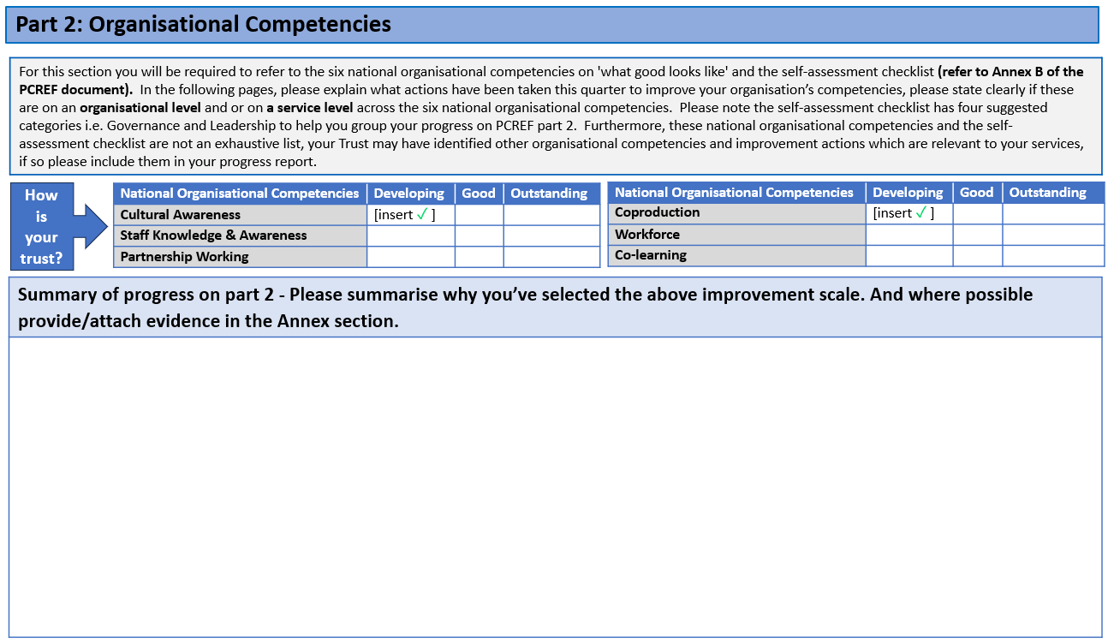

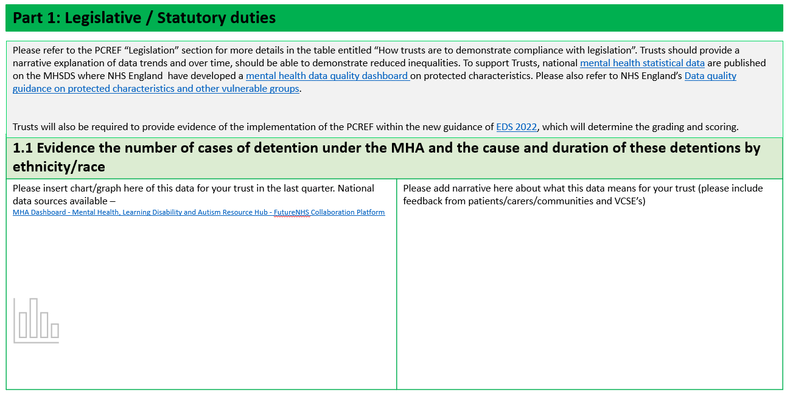

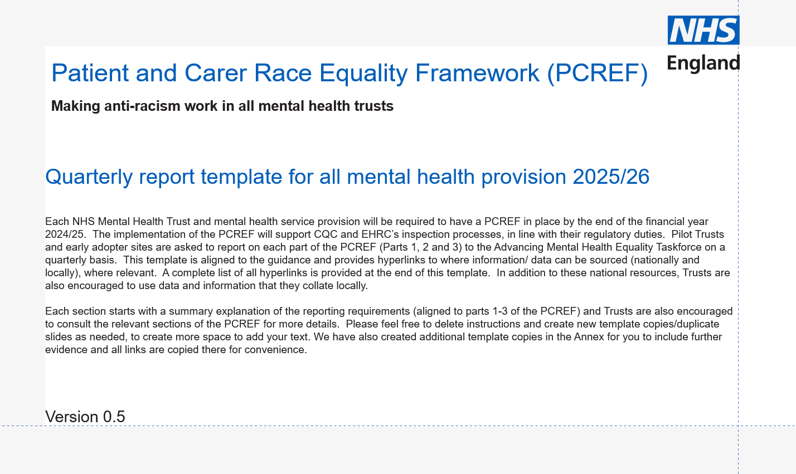
Get yourself familiar
www.england.nhs.uk/pcref
NHS Future Collaboration site
Case studies
Join NHSE’s PCREF Community Forum
PCREF report

Slide 23









Patient and Carer Race Equality Framework
NHS England (NHSE) published its first Advancing Mental Health Equalities Strategy in October 2020, laying out plans for addressing inequalities in access, experience and outcomes in mental health care.
The PCREF is a core part of the Advancing Mental Health Equalities strategy. It was also a key recommendation of the Independent Review of the Mental Health Act 2018 that NHS England (NHSE) agreed to take forward.
Now have 18 Mental Health Trusts helping NHS England to develop the PCREF
South London & Maudsley Trust
North East London Foundation Trust
Sheffield Health & Social Care Foundation Trust
Nottinghamshire Healthcare Foundation Trust
Black Country Foundation Trust
Oxleas Foundation Trust
Essex Partnership University Trust
Southwest & St George’s Trust
Leeds & York Partnership Foundation Trust
East London Foundation Trust
Gloucestershire Health & Care Foundation Trust
Greater Manchester Foundation Trust
Oxford Health Foundation Trust
St Andrew’s Healthcare Trust
South West Yorkshire Partnership Trust
Birmingham and Solihull Trust
Pennine Care Foundation Trust
Lincolnshire Partnership Foundation
Trust

Slide 24
How pilot Trusts have implemented the PCREF: good practice examples
PCREF Part 1 – Leadership and Governance
PCREF Part 2 – National Organisational Competencies
Exec lead for PCREF at board level
PCREF Monitoring and Assurance embedded
Link to ICS’s Equality objectives
PCREF governance structures have representatives from ethnic led lived experiences and VCSE’s
Link to ICS’s strategic and corporate objectives and EDS 2022
All PCREF metrics being reported on via the governance structures
Recruitment of project managers/community offices/human rights officer
Culturally Appropriate Advocacy services delivered in partnership with community led organisations
Co-developed cultural awareness training led by local community organisations
Joint working with local authority partners and a number of joint initiatives rolled out including Community Outreach/MH crisis care training/advocacy services
PCREF Part 3 – Feedback Mechanism
Pilot Trust data has been critical to shift the dial on cultural awareness and training has supported this.
Inhouse dashboard to help stakeholders understand the data produced to ensure transparency and greater accuracy of figures.
The data on restrictive practice and mental health act detention rates is being used as a learning tool to identify gaps and see where activities are having a positive impact.
Pilot Trusts are analysing various patient and carer experience tools to monitor feedback:
Working with specific VCSE's representing racialised communities to enhance awareness and understanding on feedback
Friends and Family Test Results, GP data, Complaints, Dialogue+

Slide 25
How confident do you feel about identifying and tackling racial inequity?
Question 2

Slide 26
Our PCREF Action Plan and work so far

Slide 27



PCREF three key areas to drive improvement
Leadership and governance: Our Trust board will lead on the establishment and monitoring of the new Improving Health Equity Strategic Plan to reduce health inequalities.
Understanding our data: new data set on improvements in reducing health inequalities will be published, as well as details on ethnicity in all existing data we collect.
Feedback mechanisms: visible and effective ways for patients and carers to feedback, as well as clear processes to act and report on that feedback.

Slide 28


What does PCREF mean to us in practice?
Services will be better tailored to the needs of the community
Service users from racialised communities (and their families and carers) will:
  know how to give feedback and will feel comfortable and confident to do so
  feel that their voice is being heard, including with the Trust Board of Directors
  know that their experience is being listened to, as we will regularly look at data and review their feedback to help make continual improvements to services
  feel more involved with the organisation and see opportunities to work in partnership to develop and review our PCREF plans.

Slide 29
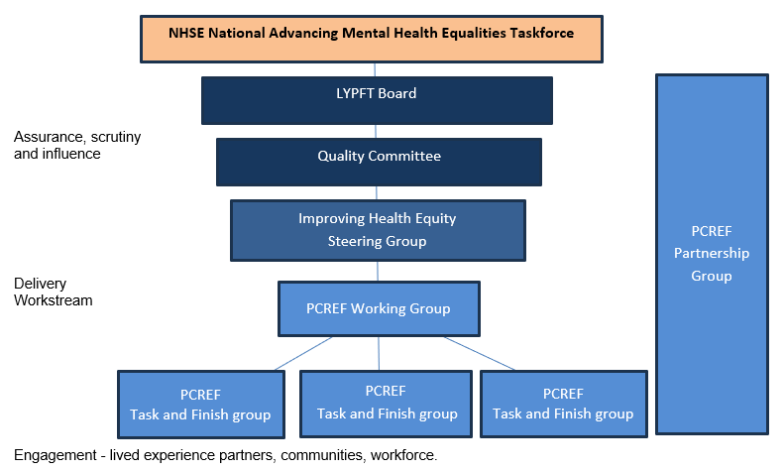
1. Leadership and governance actions
Started work with NHSE as a PCREF Early Implementor Site
Established exec PCREF leadership at Trust Board level
Working with Advancing Mental Health Equalities (AMHE) Collaborative to access board to ward health equity training & Quality Improvement techniques to advance mental health equity
Agreed our governance structure
Initiated PCREF core working group
Membership scoping of PCREF Partnership Group, terms of reference drafted
Recruitment of lived experience partners (service users and carers) in collaboration with patient experience team

Slide 30
2. Understanding our data actions
Created a first version ‘Health Equity Data Dashboard’ with specific PCREF related measures initially focusing on Mental Health Act data on dentitions and restrictive practices
Ongoing work focusing on wider review of all data & information available from sources such as:
    Feedback from patients and carers in our services
    Feedback from VCSE partners
    Friends and Family Tests - cultural experiences
    Complaints, compliments and safeguarding reports
    Patient Advice and Liaison Service reports
    Access to advocacy
    West Yorkshire Intgrated Care Board led PCREF engagement and listening sessions
    Workforce Race Equality Standard
    Workforce Race Equality Network feedback
    Patient Reported Outcomes Measures (PROMS)

Slide 31
3. Feedback mechanisms actions
Co-production
Interviews and listening events with service users, carers and community groups
Lived experience partners from diverse backgrounds supporting governance processes e.g. advisory group community mental health transformation
Peer support workers with lived experience from diverse backgrounds employed our services
Community mental health transformation insight reports ‘You said we are doing’ with racialised and culturally diverse communities
Analysing existing local reports on racialised community groups e.g. Independent Race Review (2024)
Partnership working
Relationships with grassroots community mental health groups
Commissioning for racial equity in mental health event in collaboration with Synergi Leeds in November
Community membership at Forum for Race Equality in Social and Healthcare (FRESH)

Slide 32
Patient and Carer Feedback Mechanism
Ensure patient experience and outcome measures are routinely collected to a consistently high quality, and flowed to national datasets to enable benchmarking and lessons-sharing
Routinely monitor differential experience and outcome measures, disaggregated by ethnicity, across all service pathways within the trust
Agree approaches for implementing a ‘real time’ and transparent feedback loop with ethnic minority communities

Slide 33
Highlighting some specific work areas
Work with communities to build trust
Community Mental Health Transformation Programme
Trauma informed approach delivering NHSE Culture of Care Quality Transformation Programme
Advance Choice Documents
Board to ward training via Advancing Mental Health Equalities (AMHE) Collaborative
Reciprocal mentoring
Review our policies with a racialised lens
Structured Judgement Reviews
Designing and delivering health equity city wide continuous professional development

Slide 34
What is the biggest racial inequity priority to you?
(word bubble)
Question 3

Slide 35
What is our evidence telling us?

Slide 36
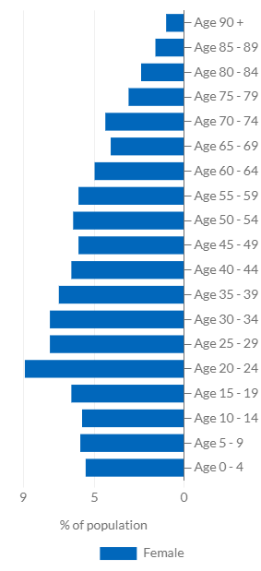
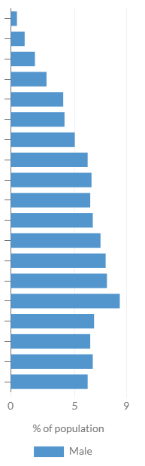
Who makes up Leeds?
Percentage of Leeds Population by Age and Sex in 2021
Equitable services must reflect the populations they serve and their health needs
Leeds has a rapidly growing population with growth fastest in inner city areas creating increased density.
Total population: 751,500 in 2011, increased to around 812,000 in 2021.
Leeds is 51% female and 49% male
Sustained growth in the population of children & young people which continues to become more diverse and is concentrated in our inner-city areas.
34% of Leeds Children live in IMD 1.
Horizon scanning: Expect significant growth in populations living in deprived inner-city areas. The need to tackle health inequalities will only continue to grow.
Source: ONS (taken from Leeds Observatory)

Slide 37
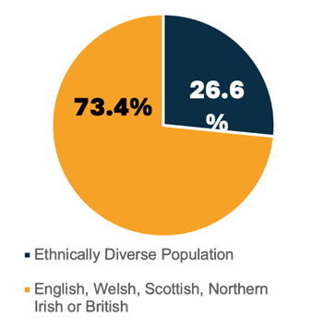
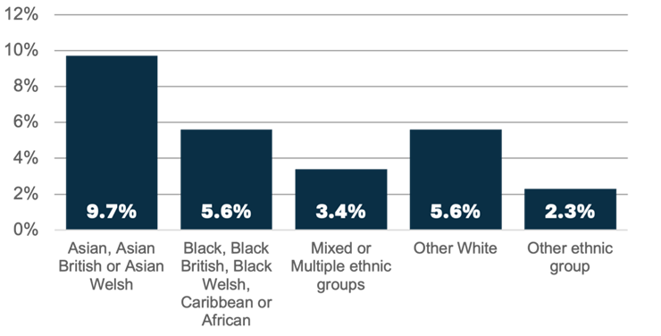
Who makes up Leeds?
Leeds is becoming more ethnically diverse
26.6% of residents coming from ethnically diverse backgrounds (Census 2021).
This has gone up from 19% in 2011 (Census 2011).
Ethnicity in Leeds, 2021 census data

Slide 38
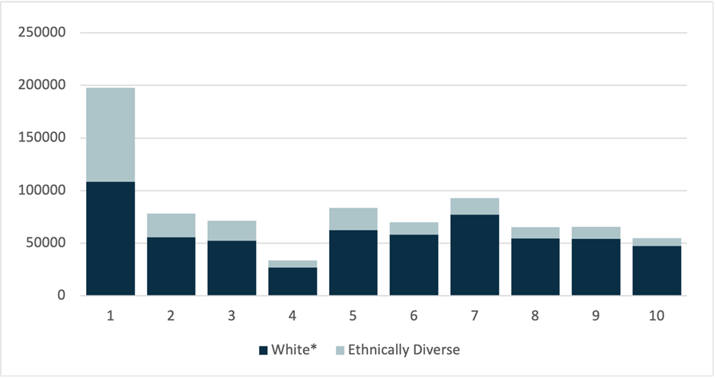
Who makes up Leeds?
Ethnicity profile for each Index of Multiple Deprivation 2019 decile
Disproportionate concentration of every ethnic group (except those who describe themselves as White) in the most disadvantaged communities in the city.
41% of all ethnically diverse people live in IMD1.
For example, over 70% of all black people in Leeds live in IMD 1 or 2.
Source: IMD 2019 and Census 2021

Slide 39
Rate of Mental Health Act Detentions by
Index of Multiple Deprivation (March 2024 / Feb 25)
Most detentions occur in those living in the most deprived areas (IMD1), and the least detentions in the least deprived areas (IMD 10).

Slide 40
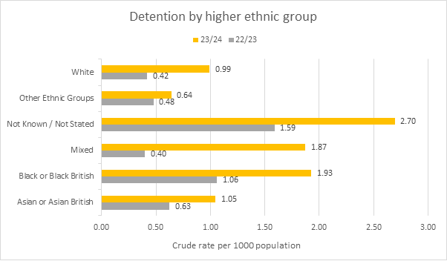
Serious Mental Illness,
Health Inequality & Ethnicity
Those with SMI from an ethnic minority background experience additional inequalities e.g.
Crisis services:
People from Black or Mixed ethnic groups in Leeds are twice as likely to be​ admitted to a mental health ward having accessed a crisis service as people from White ethnic​ groups.
This may represent higher levels of need in some population groups and/or limitations across​ mental health and social care pathways to meet the needs of these groups before crisis occurs.​
Mental Health Detentions:
In our services, Black and mixed ethnicities have a high rate per 1,000 population of mental health detentions (1.93 and 1.87 respectively), nearly double that of their white counterparts (0.99). The difference in detention rates between white and black ethnicities has widened over the last year.
LYPFT
Mental Health Detention Rates 22-24 by Ethnic Group (high-level groupings)

Slide 41
Health inequalities are affecting the communities we serve
Nationally, people with SMI die on average 15 to 20 years earlier than the general population.
People in the most deprived parts of Leeds, on average die 10 years younger than those in the least deprived areas.
Women with a learning disability die on average 27 years younger than the rest of the population.
People with a learning disability are 3 to 4 times as likely to die from avoidable medical causes.
Black adults have the lowest mental health treatment rate of any ethnic group, at 6% (compared to 13% in White British group).
Black women/birthing people are 3 times more likely to die during childbirth than white women in UK.
Black women/birthing people are 40% more likely to experience postnatal depression.

Slide 42
Panel Discussion

Slide 43
Why is the PCREF important to you?

Slide 44
Six practical steps to being anti-racist
Listen to voices of those accessing our services – how/does racial inequity show up?
Educate yourself, access training, do own research e.g. LYPFT ‘Cultural Competency and Humility Training’, West Yorkshire ICB ‘Exploring the Impact of Racial Trauma’.
Acknowledge and respect difference - actively identify, challenge and dismantle racism
Understand and use your privilege to drive improvements
Amplify voices e.g. take every opportunity to make sure your ethnicity and religion data is accurate
Take action to create an equitable, inclusive and just mental health system

Slide 45
How you can get involved in PCREF work
Get involved
  Take part in our workshops, events, and meetings to help shape our direction
  To lend your time, expertise and help us achieve our goals please contact our Improving Health Equity Team at lmh-tr.healthequity@nhs.net
2) Feedback
Attendees will receive the slide pack and links for our two feedback forms:
    Anonymous feedback form – share information, experiences or ideas related to PCREF
    Partnership work feedback - share current work you are doing around racial equity
3) Listening event (20/05/25)
The third event hosted West Yorkshire ICB Mental Health and Learning Disability Programme.
Focus: how we as providers are empowered to listen to the voices of those with the expertise and experience needed to develop anti-racist mental health services.

Slide 46
Have Your Say
Service users and carers can provide feedback at any point in their care journey by the following ways:
Complete a Have Your Say postcard (located on wards and at community sites)
access our online survey (www.myonlinesurvey.co.uk/PFFT/RGD)
scan a QR code located on wards and at community sites
Telephone 0800 052 5790
Email haveyoursay.lypft@nhs.net
We also have a version of the ‘Have Your Say’ feedback measure in an easy read version and in British Sign Language by contacting patientexperience.lypft@nhs.net

Slide 47
Thank you!
To get involved, give feedback or any further information please contact:
            lmh-tr.healthequity@nhs.net
            sophie.valinakis@nhs.net

